Slide 1
Data Visualization with Elastic Search in Kibana
Course: Data Mining
Lecturer: PHAUK Sokkhey and CHAN Sophal
Student: ROS Sereiwathna

Slide 2

Elastic Search
Elasticsearch is a distributed search and analytics engine built on Apache Lucene.

Slide 3

Kibana
Kibana is a data visualization and exploration tool used for log and time-series analytics, application monitoring, and operational intelligence use cases. It offers powerful and easy-to-use features such as histograms, line graphs, pie charts, heat maps, and built-in geospatial support.

Slide 4
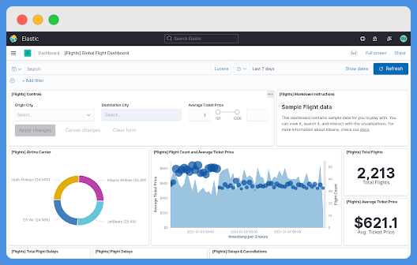
Kibana
Global Flight Data

Slide 5
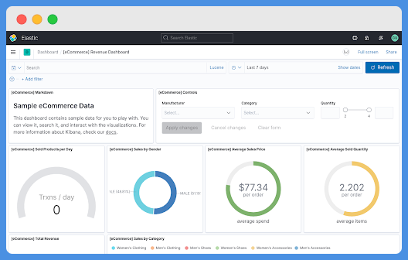
Kibana
Ecommerce Revenue Dashboard

Slide 6
Advantages of Kibana
Contains open source browser based visualization tool mainly used to analyse large volume of logs in the form of line graph, bar graph, pie charts, heat maps etc.
Simple and easy for beginners to understand.
Ease of conversion of visualization and dashboard into reports.
Canvas visualization help to analyse complex data in an easy way.
Timelion visualization in Kibana helps to compare data backwards to understand the performance better.

Slide 7
Disadvantage of Kibana
Adding of plugins to Kibana can be very tedious if there is version mismatch.
You tend to face issues when you want to upgrade from older version to a new one.

